Slide 1

Department of CSE (IoT & Cybersecurity including Blockchain)
B.M.S. College of Engineering, Bengaluru
PrivyPrint
Secure Decentralized Web3 Document Printing Platform
231C6AEWEB | Web3 Development | 6th Semester | AY 2025–26
S Rohith
O V Yogeswar Reddy
Dadapir N F
Aman Sharma
1BM23IC057
1BM23IC045
1BM24IC400
1BM23IC006
Project Guide: Prof. Susmitha Mukund Kirsur, Assistant Professor, Dept. of CSE (ICB), BMSCE.
05 May 2026

Slide 2
Index
Index
01
Introduction & Problem Statement
07
Architecture – Print Shop Flow
02
Motivation
08
Directory Structure
03
Overview
09
Security Model
04
Core Features
10
Website Images
05
Technical Stack
11
Literature Survey
06
Architecture – Sender Flow
12
Conclusion

Slide 3
01. Introduction & Problem Statement
1 Billion+
68%
$4.9M/breach
Documents printed
globally every day
Of data breaches involve
human error or negligence
Average cost of a
data breach (2025)
Source: IDC, "Worldwide Hardcopy Peripherals" 2024
Source: Verizon DBIR 2024
Source: IBM Security, "Cost of a Data Breach Report 2025"
Print shops receive sensitive documents (ID proofs, legal papers) over insecure channels like WhatsApp or email.
Central servers store plain document files — a single breach exposes thousands of users' private data.
No existing solution integrates blockchain access control, end-to-end encryption and IPFS storage for print workflows.
There is an urgent need for a Zero-PII, trustless printing platform that keeps documents out of central servers.

Slide 4
02. Motivation
Privacy is a Right, Not a Feature:
People share government IDs, medical records, and legal documents at print shops every day. This data deserves cryptographic protection, not just trust in the operator.
Decentralization Eliminates the Honeypot:
Central servers holding plaintext documents are prime targets. By encrypting on the client and storing ciphertext on IPFS, PrivyPrint removes the honeypot entirely.
Blockchain Enables Trustless Access Control:
Smart contracts encode exactly who can access a document, for how long, and how many copies without relying on human judgement or a central authority.
The Web3 Ecosystem Is Ready:
MetaMask, IPFS, and EVM-compatible chains are mature enough to power a production dApp that non-technical users can actually navigate.

Slide 5
03. Overview
PrivyPrint is a next-generation decentralized application (dApp) designed to secure the physical document printing pipeline. It enables users to share sensitive documents with print shops using end-to-end encryption, ensuring Zero-PII storage on central servers.
For Document Owners
For Print Shops
Platform Guarantees
Connect MetaMask wallet
Encrypt file locally (AES-256)
Upload ciphertext to IPFS
Register print job on-chain
Set expiry & copy limits
Connect MetaMask wallet
Encrypt file locally (AES-256)
Upload ciphertext to IPFS
Register print job on-chain
Set expiry & copy limits
Monitor incoming job queue
Decrypt access key via MetaMask
Fetch & decrypt file from IPFS
Preview in secure browser sandbox
Confirm print on-chain
Monitor incoming job queue
Decrypt access key via MetaMask
Fetch & decrypt file from IPFS
Preview in secure browser sandbox
Confirm print on-chain
Zero plaintext on any server
Trustless wallet-based identity
Automatic time-based expiry
On-chain revocation at any time
No file saved locally on print side
Zero plaintext on any server
Trustless wallet-based identity
Automatic time-based expiry
On-chain revocation at any time
No file saved locally on print side

Slide 6
04. Core Features
01
Wallet-Gated Identity
02
End-to-End Encryption
Users and print shops authenticate via MetaMask no passwords, no email, no PII registration required.
Documents are encrypted locally in the browser with AES-256 before any upload. The server never sees plaintext.
03
Asymmetric Key Exchange
04
Blockchain Access Control
The AES access key is encrypted specifically for the recipient print shop's x25519 public key via MetaMask.
Print jobs are registered on an EVM blockchain managing permissions, status tracking, and copy limits on-chain.
05
Timed Expiry
06
Secure Preview & Print
Access to documents expires automatically based on the blockchain timestamp enforced both on frontend and smart contract.
Print shops preview and trigger native printing in a sandboxed interface without ever saving files locally.

Slide 7
05. Technical Stack
Layer | Technology | Purpose
Frontend Framework | Next.js 15 (App Router) + TypeScript | Server components, routing, type safety
Styling / Animation | Tailwind CSS (Glassmorphism) + Framer Motion | Responsive UI with polished transitions
Blockchain | Ethers.js v6, Hardhat, Solidity | Contract interaction, local dev chain, EVM contracts
Encryption | Crypto-JS (AES-256) + MetaMask (x25519-xsalsa20-poly1305) | Local file encryption & asymmetric key exchange
Storage | IPFS via Pinata | Decentralized storage of encrypted ciphertext
Database | MongoDB via Mongoose | User profiles and job metadata (no document content)
Auth | NextAuth.js (Credentials + Wallet logic) | Session management combined with wallet identity

Slide 8
06. Architecture – Sender Flow
1
Connect MetaMask wallet to the PrivyPrint dApp.
2
Browse and select a registered Print Shop from the directory.
3
Upload a PDF document; a unique AES-256 access key is generated locally.
4
The file is encrypted in the browser with the AES key — no plaintext leaves the device.
5
The encrypted ciphertext is pinned to IPFS via Pinata; the returned CID is stored.
6
The AES key is encrypted with the Print Shop's x25519 public key via MetaMask.
7
A "Print Job" transaction is submitted on-chain containing the IPFS CID, encrypted AES key, expiry, and copy count.

Slide 9
07. Architecture – Print Shop Flow
1
Connect MetaMask wallet and navigate to the Incoming Queue dashboard.
2
View pending print jobs assigned to this shop's wallet address.
3
Select a job; decrypt the AES access key using MetaMask's private key (x25519-xsalsa20-poly1305).
4
Fetch the encrypted ciphertext from IPFS using the stored CID.
5
Decrypt the ciphertext locally in the browser using the recovered AES key.
6
Preview the document in a sandboxed interface; trigger the browser's native print dialog with hidden options to save as or other options.
7
Submit an on-chain confirmation transaction to mark the job complete and clear access.

Slide 10
08. Security Model
Zero-PII Storage
Trustless Access Control
No unencrypted document data ever leaves the user's machine. The server and IPFS only ever see AES-256 ciphertext meaningless without the private key.
Only the assigned print shop's MetaMask wallet can decrypt the file-level AES key. The platform operator has zero ability to access any document.
On-Chain Revocation
Time-Based Expiry
Senders can revoke a print job on-chain at any time before the shop confirms completion. The smart contract immediately rejects further decryption attempts.
Both the frontend and the smart contract enforce expiry based on the on-chain timestamp, ensuring documents are never accessible indefinitely after job creation.

Slide 11
09. Directory Structure
app/
Next.js pages and API routes (api/, sender/, print-shop/)
components/
Reusable UI: AppShell, Button, GlassPanel, and more
contracts/
Solidity smart contracts managing platform logic on-chain
lib/contract.ts
On-chain interaction — reading and writing print job state
lib/encryption.ts
Local AES-256 and asymmetric encryption / decryption utilities
lib/wallet.ts
MetaMask connection, network detection, and account management
lib/ipfs.ts
Pinata integration — upload encrypted ciphertext and fetch by CID
models/
Mongoose schemas for user profiles and job metadata in MongoDB
scripts/
Hardhat deployment and utility scripts for the local dev environment

Slide 12
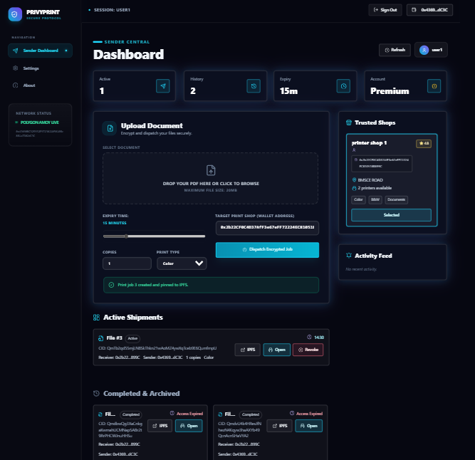
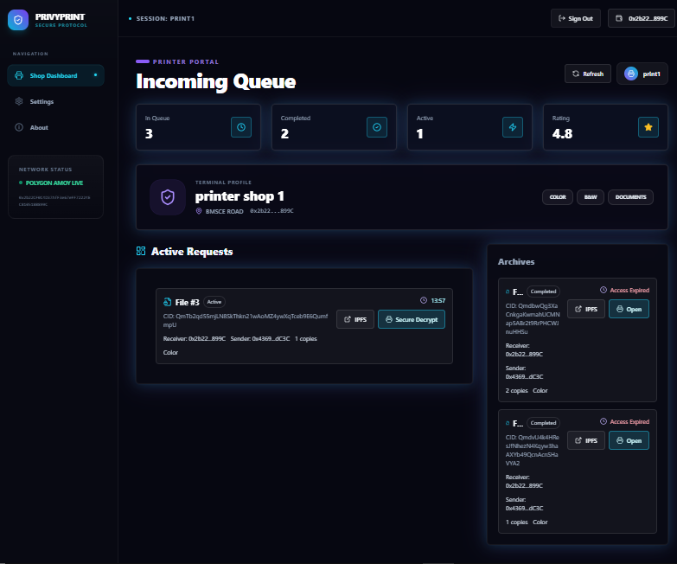
10. Website Images
Sender Dashboard
Printer Shop Dashboard

Slide 13
11. Literature Survey (1/3)
P.No | Title of Paper | Year | Key Outcome | Gap Identified
1 | Secure Document Verification using Blockchain & IPFS with Threefish Encryption and QR Code Integration | 2025 | Threefish-encrypted documents stored on IPFS; Ethereum+Solidity used for tamper-proof verification ledger, addressing 51% attack resistance. | No access-expiry or key delegation mechanism; single owner model only cannot transfer decryption rights to a third party (e.g., print shop).
2 | Paperless Everything: A Systematic Literature Review for Blockchain-based Document Management Systems | 2025 | Reviewed 1,737 papers; found dApp-based (38%) and proxy-based (48%) architectures dominate; off-chain storage preferred (68%). | No paper integrates physical output (printing); all systems stop at digital delivery. Smart contract testing coverage extremely low (22%).
3 | Design and Implementation of a Decentralized Document Management System | 2025 | DDMS uses IPFS + blockchain for integrity; symmetric key split via Shamir's Secret Sharing across multiple users for distributed permission. | Multi-user key reconstruction adds latency and complexity; no time-based expiry or single-recipient delegation for controlled one-time access.
4 | Blockchain-based Secure and Verifiable Storage Scheme for IPFS-assisted IoT with Homomorphic Encryption | 2025 | Homomorphic encryption allows computation on ciphertext in IPFS; blockchain verifies storage proofs for IoT device data integrity. | Homomorphic encryption is computationally expensive for large files (PDFs). Not suitable for real-time browser-based document decryption workflows.

Slide 14
11. Literature Survey (2/3)
P.No | Title of Paper | Year | Key Outcome | Gap Identified
5 | CipherDrop: Secure Encrypted File Sharing using AES-256 and Zero-Knowledge Architecture | 2025 | AES-256 CBC client-side encryption before upload; server acts as opaque relay for ciphertext zero-knowledge server model demonstrated. | Centralized relay server remains a single point of failure. No blockchain access control; revocation and expiry rely on server-side logic only.
6 | The State of Encryption in Web3 (Safe Research Foundation) | 2025 | Maps E2EE landscape in Web3; identifies MetaMask EIP-1024 deprecation and x25519-xsalsa20-poly1305 via Snaps as the viable asymmetric path. | No unified standard yet; wallet support is fragmented. Most dApps still avoid E2EE highlights the exact gap PrivyPrint addresses in print workflows.
7 | Implementation of Secure E2E Encrypted Chat using Diffie-Hellman Key Exchange and AES-256 in a Microservice Architecture | 2025 | DH key exchange + AES-256 in microservice setup ensures session-level encryption. Modular services reduce single points of failure. | Symmetric session keys are ephemeral and cannot be archived for third-party access delegation. No on-chain audit trail or time-bound access control.
8 | Privacy-Preserving Genomic Data Sharing via Hybrid AES/ECC and Blockchain-Based Dynamic Consent | 2025 | AES bulk encryption + ECC key protection + IPFS off-chain storage + Ethereum smart contracts for consent-aware access control at genomic scale. | Domain-specific to healthcare/genomics; no physical output layer. Consent model is long-term not designed for short-lived timed access like print jobs.

Slide 15
11. Literature Survey (3/3)
P.No | Title of Paper | Year | Key Outcome | Gap Identified
9 | MedAccessX: A Blockchain-Enabled Dynamic Access Control Framework for IoMT Networks | 2025 | Combines ABAC and RBAC in smart contracts for dynamic, privacy-preserving data sharing across healthcare providers with cost efficiency. | Policy enforcement is role/attribute based not wallet-key based. Requires identity provider for ABAC attributes; incompatible with trustless wallet identity.
10 | Blockchain-enhanced Smart Contracts for Formal Verification of IoT Access Control Mechanisms | 2025 | Formal CTL verification of smart contract properties using FSM and NuSMV; auto-generates deployable Solidity from verified models. | Verification framework only no implementation of document storage or key delegation. Does not address user-facing dApp UX or file access workflows.
11 | Securing RC Based P2P Networks: Blockchain Access Control for IoT and Web 3.0 | 2025 | ACC + Judge Contract + Register Contract triad provides CIA/STRIDE-evaluated dynamic access control for decentralized P2P/Web3 networks. | Framework targets network-level access; not file-level. No integration with IPFS storage or asymmetric key delegation for specific recipient wallets.
12 | A Scalable, Privacy-Preserving Decentralized Identity Framework based on Zero-Knowledge Proofs | 2025 | zk-STARKs-based DIDs allow users to prove credential attributes (e.g., age > 18) without revealing underlying data; VCs on Ethereum. | ZKP infrastructure adds significant complexity and gas overhead. Wallet-native asymmetric key exchange (MetaMask Snaps) is simpler and sufficient for PrivyPrint's identity model.

Slide 16
12. Conclusion
PrivyPrint demonstrates that it is possible to build a fully trustless, Zero-PII document printing pipeline using blockchain, IPFS, and client-side encryption without sacrificing usability.
Zero-PII Achieved:
No plaintext ever reaches a central server. Encrypted ciphertext on IPFS is worthless without the private key.
Trustless by Design:
Smart contracts replace human trust. Access, expiry, and revocation are enforced cryptographically on-chain.
Practical Web3 UX:
MetaMask authentication and an intuitive dashboard make the platform accessible beyond a developer audience.
Future Scope:
Multi-chain support, mobile MetaMask integration, NFT-based print shop licensing, and zk-proof based verification.

Slide 17
Thank You
PrivyPrint | Dept. of CSE (ICB), BMSCE | MPP-1

